Slide 1
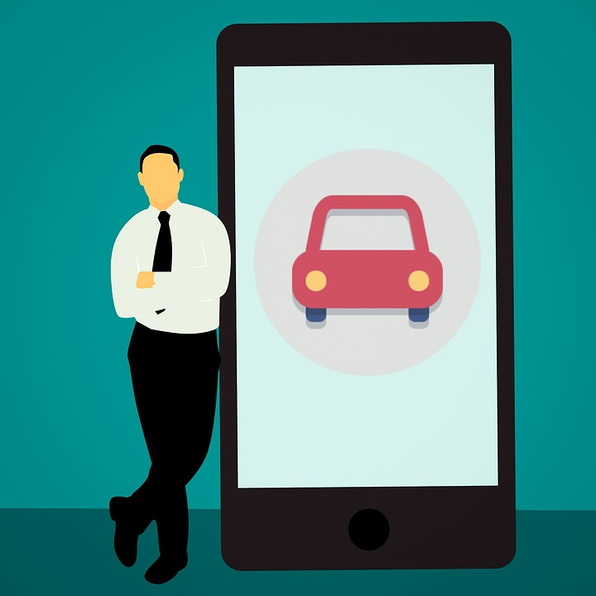
Car Rental : Mobile web-based application use to reserve a car in Batangas City

Slide 2
Introduction
The car rental app is a Mobile based application fully combined with effectively and efficiently manual procedures. Customers are supported by this automated method. Which allows them to fill in specifics according to their needs. Also sort a car they want to reserve. As well as the location, a car brand, price and duration time for renting.
SDG goal no.11 Sustainable cities and communities
The persons who will need a car must visit directly to the rental car branch business. Instead of just finding an easy way, a kind of automobile rental car application to just easily reserve and rent a car quickly. Another method that improves client confinement. It is also a form of car and employee management straightforward.

Slide 3
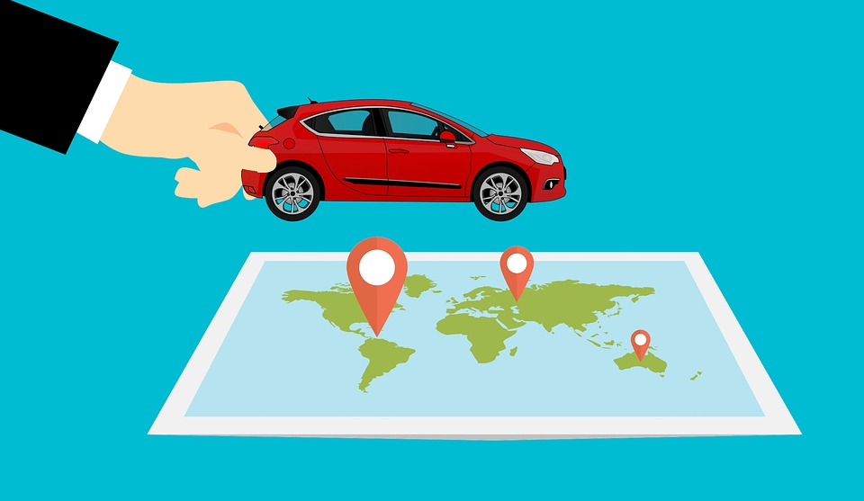
Demo of Application
Features:
User Registration
Users Authentication
Update Data
Post Data
Delete Data
Counts data
User friendly
Modern UI
API Integration
Handle Errors

Slide 4
Business Components and how it will help for the user which is Customer?
Frontend:
Ionic Angular ?
Backend:
Why firebase?
Easy to integrate for an application
Reliable Databases
Fast Workflow
Ready to user services
All-in-one platform
Free
Services Used:
Firebase Firestore (NoSQL Database)
Firebase Authentication (User authentication)
Firebase Storage (Cloud storage)

Slide 5
Group Participation
Joshua Salve L. Quinal - Programmer for who code the UI and Function, Database (firebase)
Clarissa Jean G. Fabregas - Programmer for who Coding of UI and Responsible for the Document
Cyra Bentir - Coding of UI and Creating the Design of UI
Jeoma Raye A. Almazan - Coding of UI and Responsible for the Document

Slide 6
Thank you !

